Slide 1
Continuous Integration
Definition, Setup and Tools

Slide 2
Definition
Continuous Integration allows you to deliver new software and update existing software faster, with lower risk.
Reducing risk is important, but the processes that underpin continuous integration translate into even more important values to the business:
The integration is done continuously. Using a tool like Jenkins, providing notification early and often of any problems. This make small deliverables routine - patches, small projects, UI changes, upgrades, new features.
Accelerate time-to-value. A big business that has mapped out its value stream and has complex investments and obligations across a large organization will find that continuous delivery helps accelerate time-to-value.
Data-driven decision making. Deploy, measure, adjust. You can still push larger scale releases, but your processes will be better suited to continuous data gathering.
Quality. Behaving like you’re releasing continuously forces you to raise your quality bar and fully automate test practices. Better quality means happier customers, lower costs, fewer fire-drills, and less unplanned work.
Reduce cost. Big releases have big costs and big consequences when things go wrong. Keeping small deliverables continuously in a cycle of automated testing and integration drives the cost of delivery downward.
With CI we have frequent releases of smaller amounts of functionality. This avoids all the pressure, escalations, and rollbacks, while enabling reliable, predictable releases.

Slide 3
What CI is not
Continuous Integration designed correctly will appear as a seamless pipeline with a near instant feedback loop. But we must remember there is no such thing as The Standard Pipeline.
A typically CI pipeline will include the following stages:
build automation
continuous integration
est automation
deployment automation
For each one of these areas there are choices and tradeoffs to be made.
You wll need to select the correct technologies that meet your business goes and fit with your tech stack.
Consider the options you´ll need:
Machine Virtualization Technology
Application container to make deployment to separate environments easier
A Job Manager to tie this all together in a sensible user experience
A Repository Manager for separate build maintenance and distribution
So Continuous Integration is more of a principle than a technology with multiple point of failure if not implemented correctly.

Slide 4
What is needed to implement CI
Necessary components for a Continuous Integrations Environment at minimum should consist of:
First you'll need some virtualization software like Virtualbox
which allows you install ¨Guest OS¨ on the same server.
It's best to use environment wrapper like Vagrant which allows you to easily control the creations of these “Guest OS´s”
The net effect is that you can create a prod env and redeploy that on a virtual os as a test and dev env.
Next we want to make our application development as portable as possible, as most system today are distributed. Here Docker is a good choice. It wraps all you application and its specific needs into a ¨Container¨ which can be deployed to any server also running docker.
You will need Code Version Control System like GIT that can be monitored for commits.
An Automation Server to pick up your GIT changes will be essential. It will start the build, test, run, deploy cycle.
what we call the full integration life cycle, Jenkins is a good choice here.
Finally it´s good to have a Registry (Repository) to make your Docker Containers/images available.
Docker comes with it´s own hub.docker.com to manager you Docker images
But you can also configure docker to point to an external Repository like NEXUS.
We tie all this together with Ansible. As scripting language compatible with this environment.

Slide 5
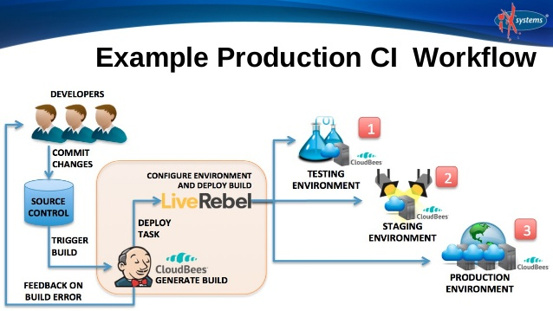
How the CI process looks like and which intefaces there are
Application
CI Server - build cycle

Slide 6
How the CI process looks like and which intefaces there are (Continued)
An Explanation of the CI processes and its interfaces
Developers check out code into their private workspaces.
When done, commit the changes to the repository.
The CI server monitors the repository and checks out changes when they occur.
The CI server builds the system and runs unit and integration tests.
The CI server releases deployable artefacts for testing.
The CI server assigns a build label to the version of the code it just built.
The CI server informs the team of the successful build.
If the build or tests fail, the CI server alerts the team.
The team fix the issue at the earliest opportunity.
Continue to continually integrate and test throughout the project.

Slide 7
Which tools are on the market
Virtualization Products
VirtualBox
VM Workstation
QEMU
Citrix XenServer
Virtualization Wrapper (automating and provisioning)
Vagrant
Virt-Manager
Apache Mesos
Otto
Distributable Software Containers
Docker
Parallels Desktop
Panamax
Configuration and Management Scripts
Ansible
Puppet
Chef
Fabric
Continuous Integration
Jenkins
Travis CI
Distelli
JetBrains TeamCity

Slide 8
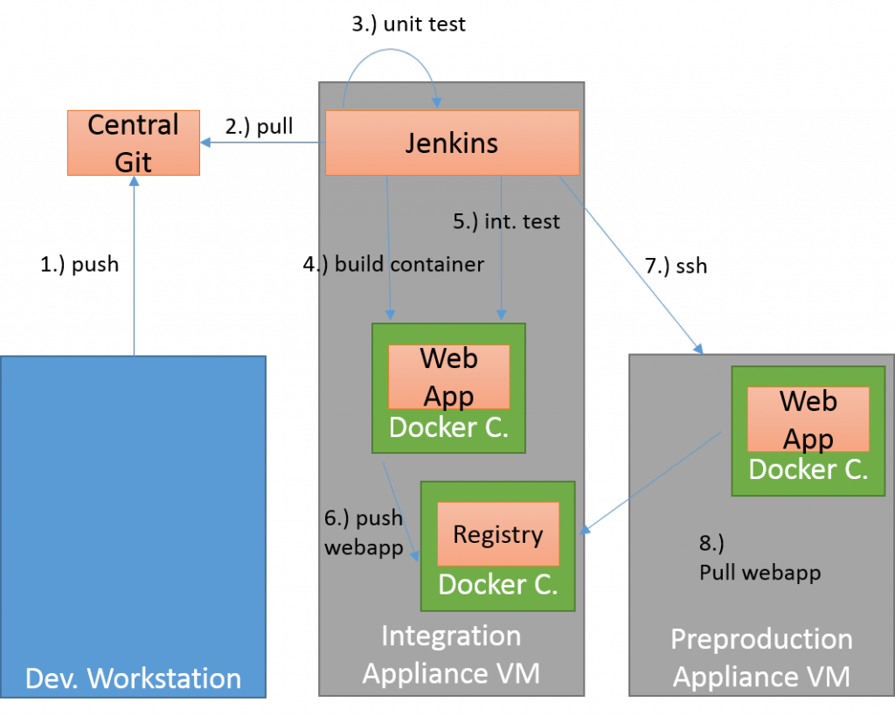
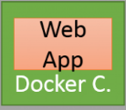
Example: Git / Jenkins / Ansible / Docker (/ Vagrant)
Staging
VM
Prod
VM
Vagrant CI
VM
Vagrant Test
VM

